Slide 1
Investigation and professional communication
Bachelor 1st semester exam

Slide 2
Performance comparinon of machine learning techniques
Ensemble learning vs standard techniques

Slide 3
Research workflow
Desk research
Research questions
Deciding on methods
Carring out the experiment
Evaluating the results

Slide 4
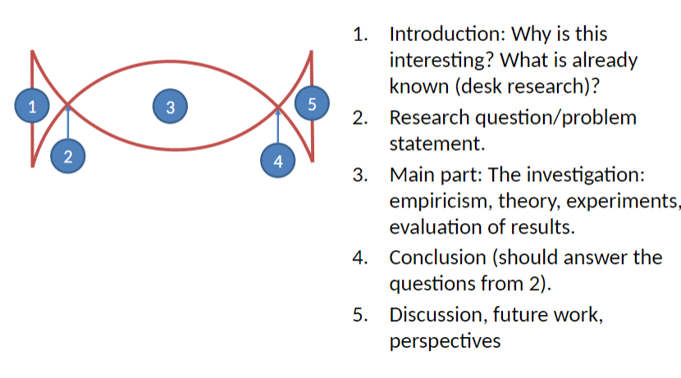
Bon Bon model

Slide 5

Desk research – David Opitz

Slide 6

Research questions

Slide 7
Deciding on methods
Theory
Practice
Experiments
Benchmarking

Slide 8
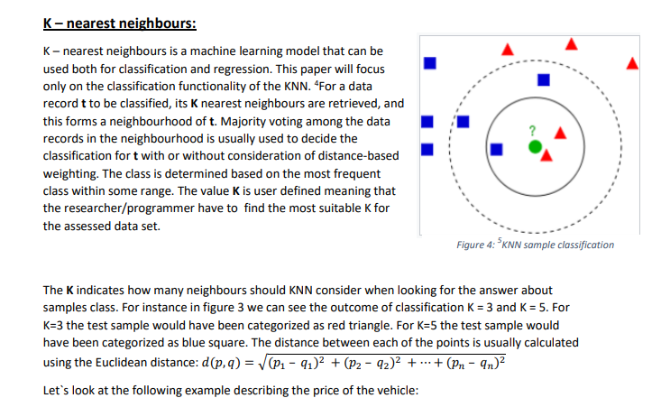

Slide 9
Research type
Secondary type of the data
Quantitive research
ANOVA in evaluation

Slide 10
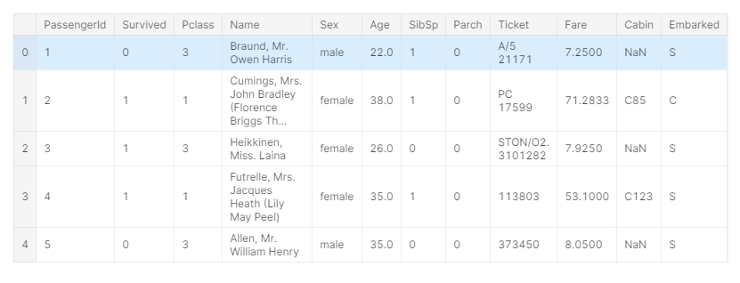
Titanic dataset

Slide 11
Benchmark
Randomized runs
Means comparison
P values

Slide 12
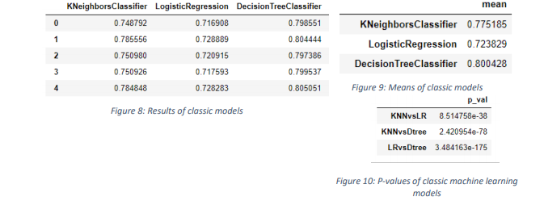

Slide 13
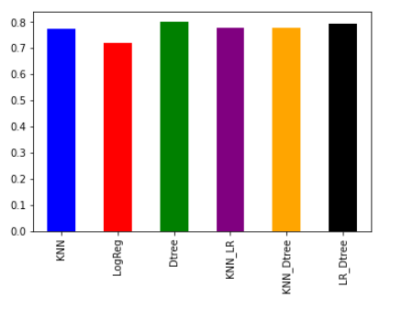

Slide 14
Conclusions
Decision trees outperformed the dataset
Not every ensemble works
Future: Bagging/Boosting
Carring out a research is an educational process

Slide 15

Thank you

